Slide 1
FINGERPRINT RECOGNITION
SUBMITTED BY:
SHUBHDEEP GAUTAM(RA1811003010273)
MRETUL MADAV(RA1811003010278)
ANOUSHKA HALDER(RA1811003010283)
ADYASHA PATTANAIK(RA1811003010293)
RAGHU B(RA1811003010303)

Slide 2
INTRODUCTION
Fingerprint recognition (sometimes referred to as dactyloscopy) is the process of comparing questioned and known fingerprint against another fingerprint to determine if the impressions are from the same finger or palm. Our process is divided into the following steps: 1. Data Collection 2. Pre-processing 3. Feature Extraction 4. Classification
We have collaborated on Google Collab and completed this project.

Slide 3
DATA COLLECTION

Slide 4
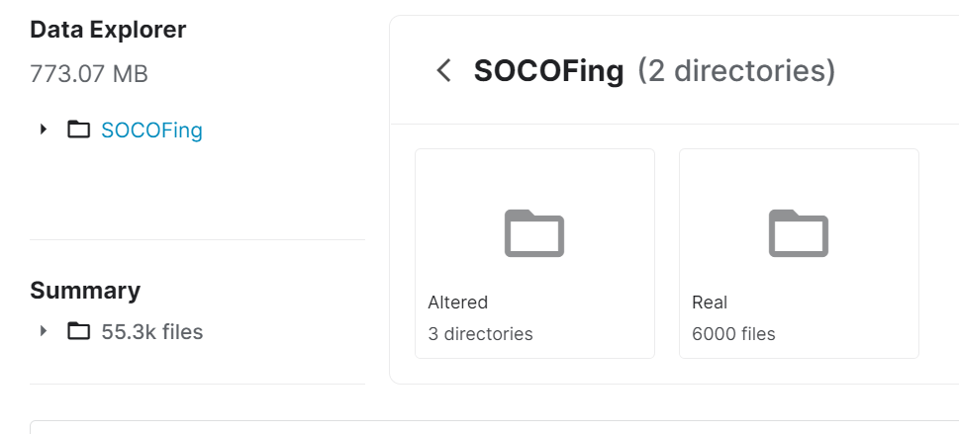
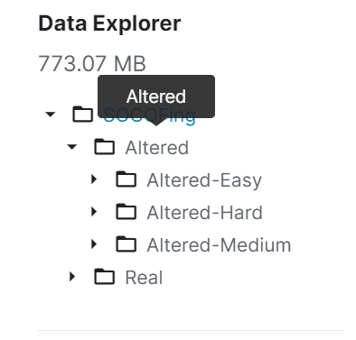
We downloaded a dataset called SOCOFING from Kaggle. SOCOFing contains unique attributes such as labels for gender, hand and finger name as well as synthetically altered versions with three different levels of alteration for obliteration, central rotation, and z-cut. The particular dataset had the following folders: 1. Altered 2. Real
Altered is further divided into easy,medium and hard. Real consists of 6000 images of actual fingerprints which is our raw data. Altered consists of around 55,000 total images which are the above mentioned altered versions.
The format of the altered images looks like this ”100__M_Left_thumb_finger_CR.BMP”, while that of real images looks like this ”100__M_Left_thumb_finger.BMP”.We are to classify base on gender that is “M” and”F”

Slide 5
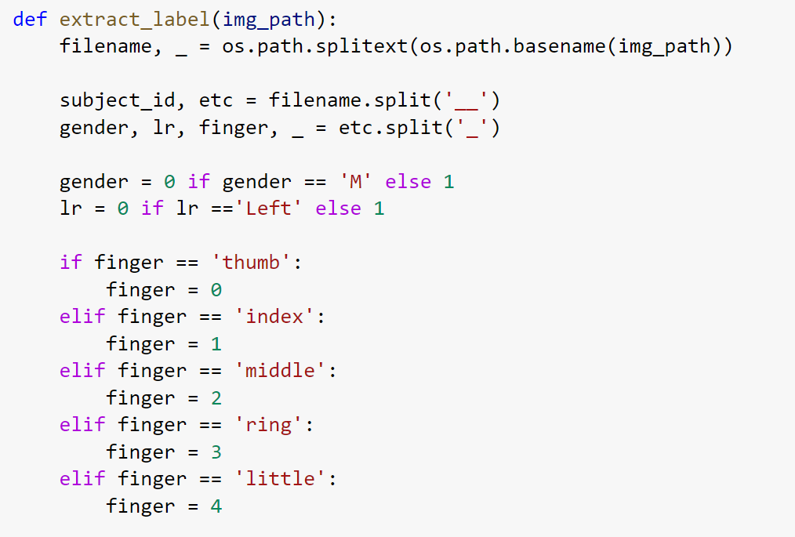
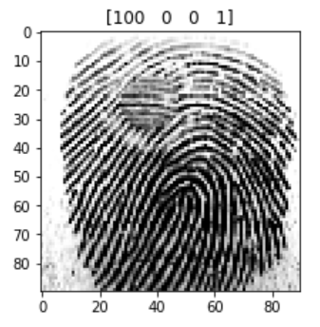
After mounting drive on Collab, we use a function to help us extract our labels.This function iterate through the image labels of the image path(img_path) assigned to it, splits the image labels to obtain F and M then assigns 0 to M and 1 to F.It returns an array of zeros and ones, with zero representing ‘M’ and 1 representing ‘F’. To apply this function to images in Real folder we will set train = False while for images in Altered folder we will set train = True.

Slide 6
PRE-PROCESSING

Slide 7
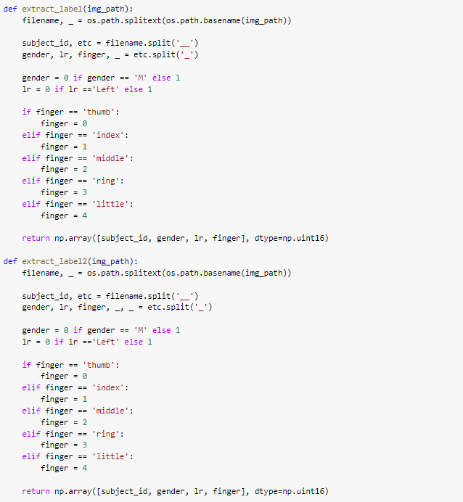
Data pre-processing or data cleansing is a crucial step and most of the ML engineers spend a good amount of time in data pre-processing before building the model. Some examples for data pre-processing includes outlier detection, missing value treatments and remove the unwanted or noisy data.
Pre-processing is a common name for operations with images at the lowest level of abstraction — both input and output are intensity images. These iconic images are of the same kind as the original data captured by the sensor, with an intensity image usually represented by a matrix of image function values (brightnesses). The aim of pre-processing is an improvement of the image data that suppresses unwilling distortions or enhances some image features important for further processing, although geometric transformations of images (e.g. rotation, scaling, translation) are classified among pre-processing methods here since similar techniques are used.
In this project we have divided all the 6000 data files and labelled them with file names,gender,type of finger(thumb,index,etc.)

Slide 8
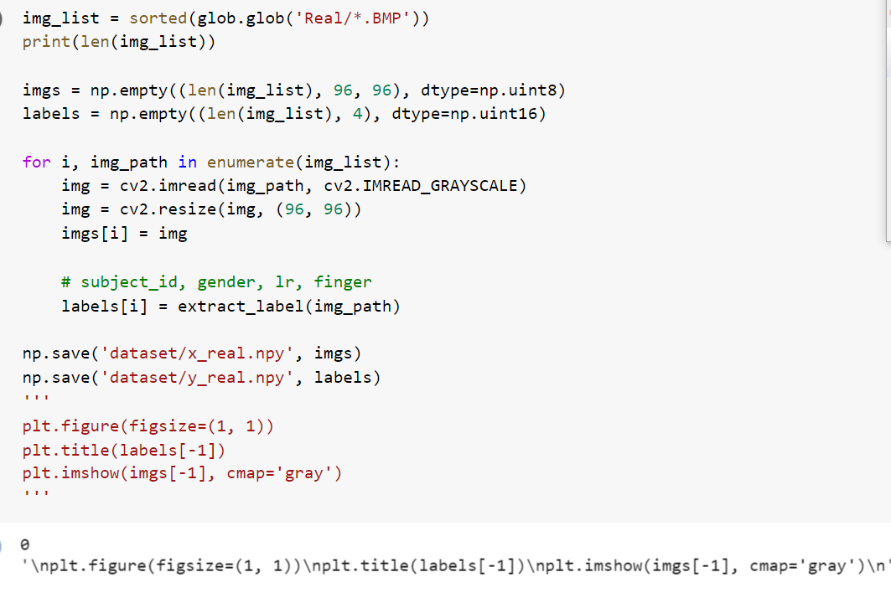
All the data (i.e. real and altered) are divided into easy,medium and hard according to the data set.

Slide 9
AUGMENTATION

Slide 10
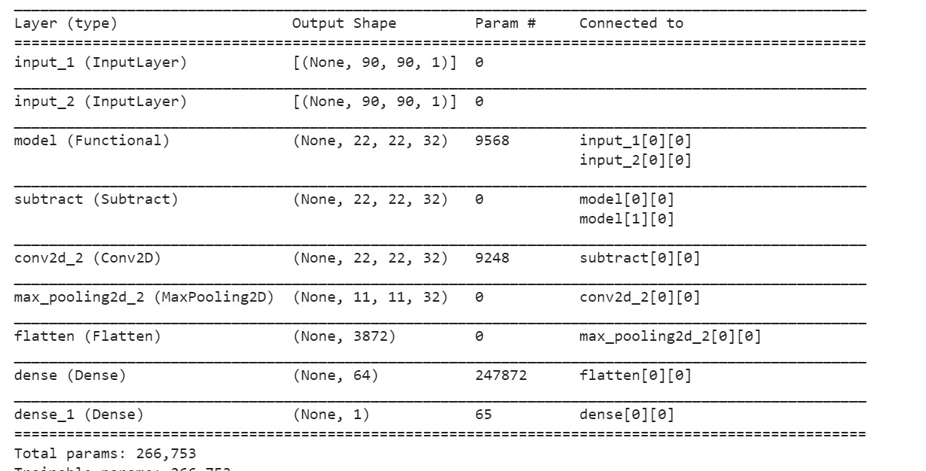
Augmenting the images so that they represent images taken from the real world as not all fingerprints can or will be taken perfectly.
We augment the data so it represents a wild environment.
Our input_shape = [90,90,1]
Our class number is two.
Each of our convolutional layer(Conv2D) consist of 32 filters each of size 3 ,We set our input shape in the first layer only
Maxpooling layers(MaxPooling2D) have a pool size of 2.
We are having a categorical-classification problem , we will end the network with an output Dense layer of size 2 (class number) and a softmax activation.

Slide 11
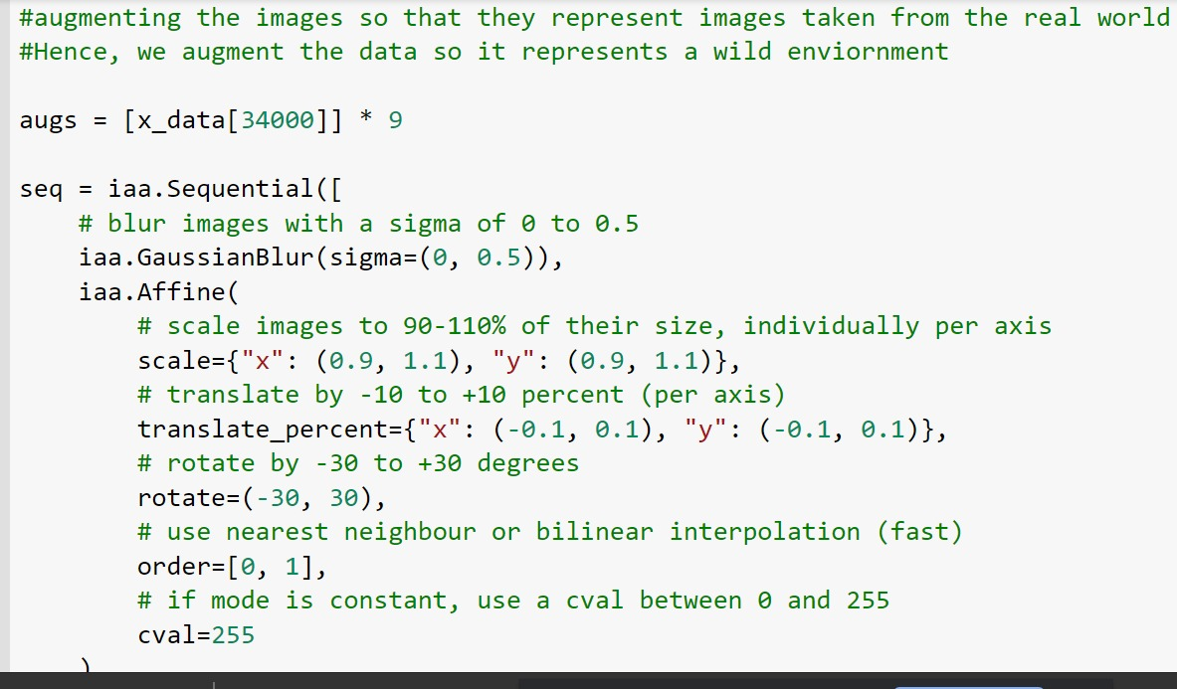
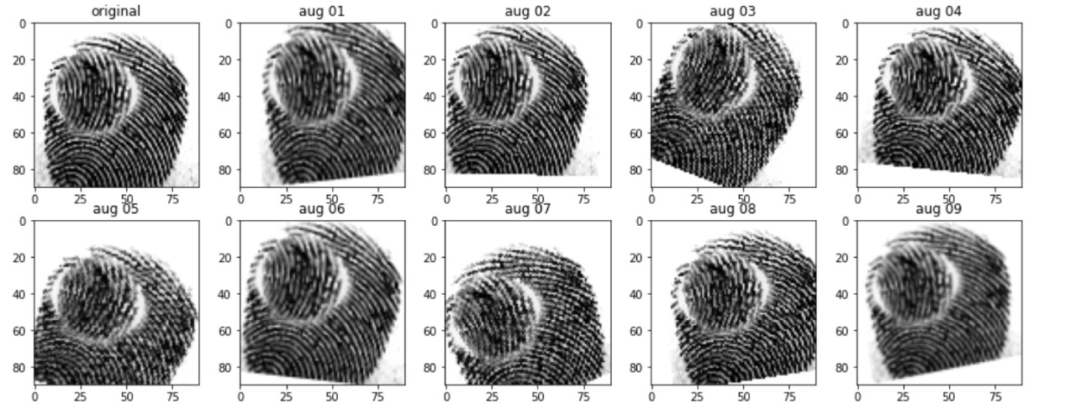

Slide 12
CLASSIFICATION

Slide 13
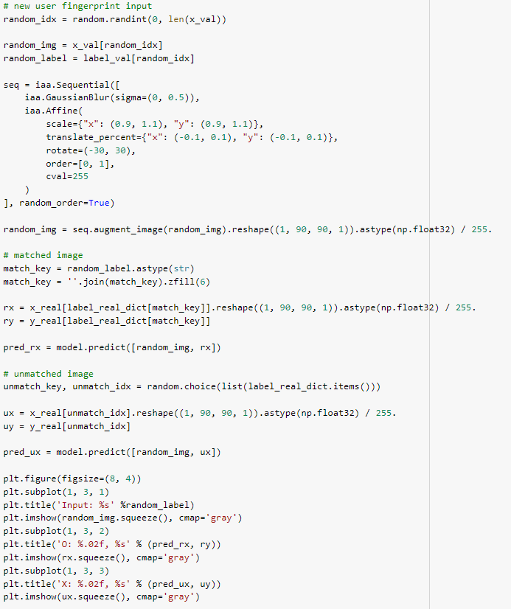
Fingerprint classification is a procedure in which fingerprints are grouped in a consistent and reliable way, such that different impressions of a same finger fall into a same group.
It can be viewed as a coarse-level pre-matching procedure so that a query fingerprint needs to be further compared with only a smaller subset of fingerprints in the database belonging to the same group.
It is often necessary to integrate a classification module into a fingerprint identification system to speed up the database search.
A fingerprint recognition system captures a user’s fingerprint and compares it with the information stored in a database to establish or to authenticate his/her identity.

Slide 14
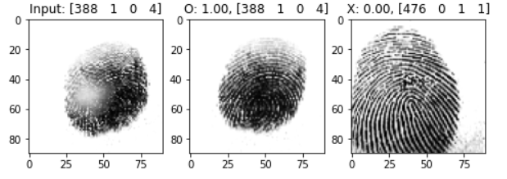

Slide 15
CONCLUSION

Slide 16
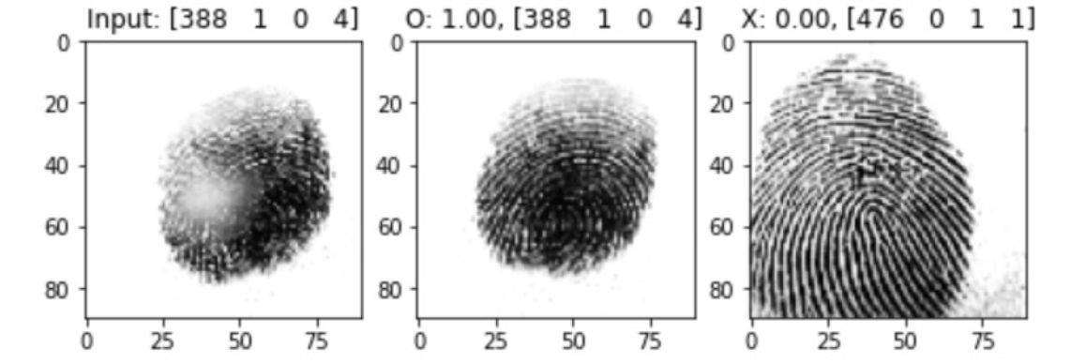
RESULT:
Let's assume that left image is a new input from user, center and right images are stored in database.
Title of figures [388 0 0 1] means, left to right order:
subject_id
gender (male 0, female 1)
left_or_right_hand (left 0, right 1)
finger index (0-4)
Applied some augmentation(gaussian blur, zoom, translation, rotation..) to input(left image) for wild environment.
Center image is the answer so it has 100% confidence, on the other hand, right image is wrong so that has 0%.

Slide 17
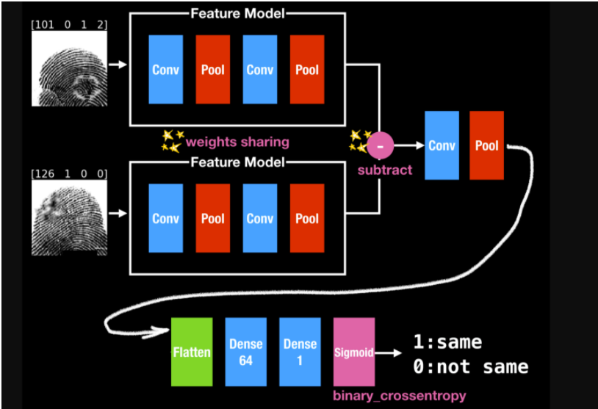

Slide 18
THANK YOU

